Slide 1
Digital News Platform (8th of August 2022)
-Shuwetha.R
-Geethika Kanna
-Hrushikesh Ingle

Slide 2
INTRODUCTION
A web system that can display news, divided into several categories, each subdivided into more categories.
Every news article has a like, comment, and share button.

Slide 3
APPROCAH
Modularity
Major use of Angular functionalities
Use of needful RestAPIs
News API
CRUD operations
Bootstrap
Dependency injections

Slide 4
CHALLENGES
Finding the appropriate news API provider.
Attaching like , comments to the news articles.
Admin Data analytics.
Proper design of entities.
Implementing news in subcategories.
Storing real time news in Database and updating as and when required.

Slide 5
LEARNINGS
Frameworks used:-
Spring Boot
Angular
Database used:-
MYSQL workbench
Fetching daily news
Using news API

Slide 6
Learnings..
How do news API work in real time.
How CRUD operations work on real time.
How dependency injections help.
How Databases are helpful in fetching necessaries.
Rest APIs and Annotations.

Slide 7
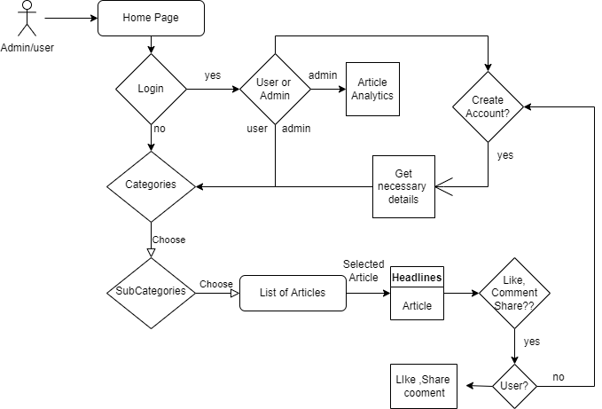
FLOWCHART

Slide 8
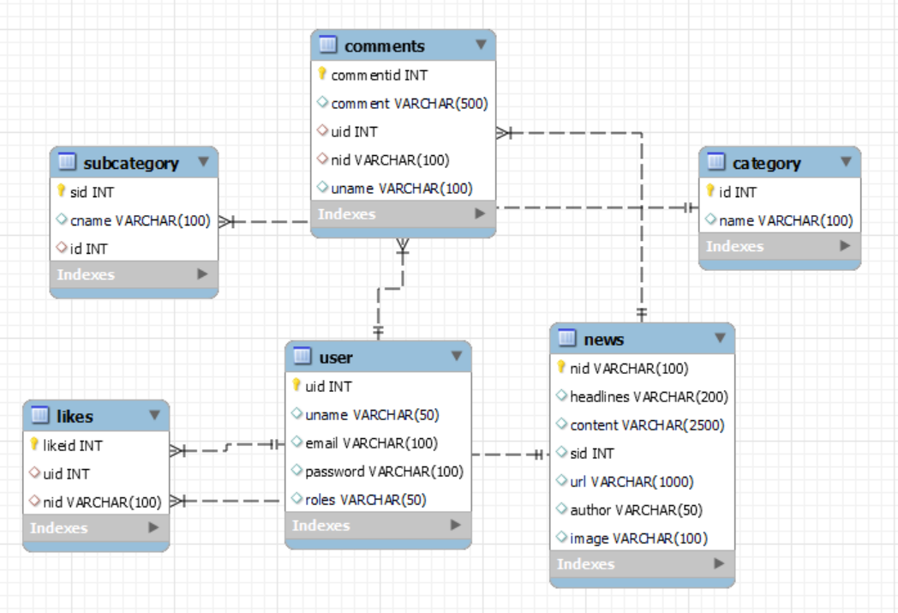
ER Diagram

Slide 9
Statistics
Angular:
Components: 7
Services: 2
Spring Boot:
Entities: 6
Repository:6
Service: 3
Controller : 2
Provider: 3

Slide 10
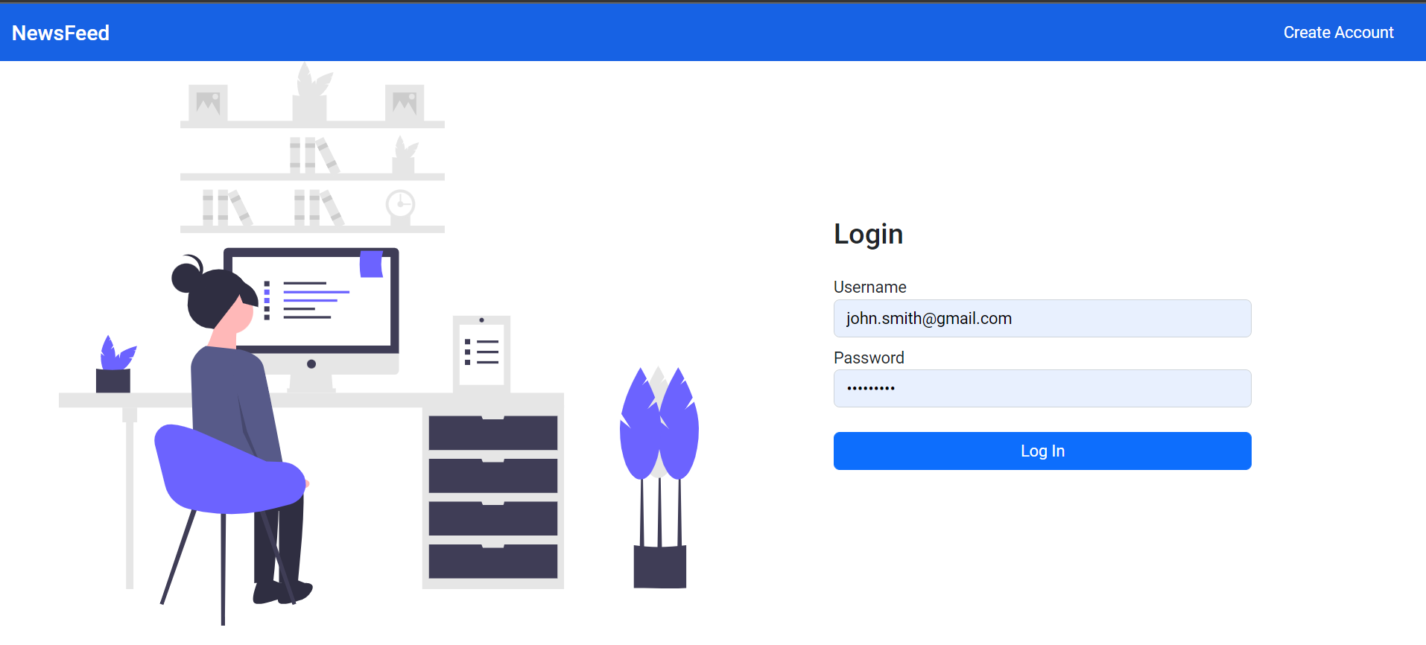
Screenshots of webpages (Login page)

Slide 11
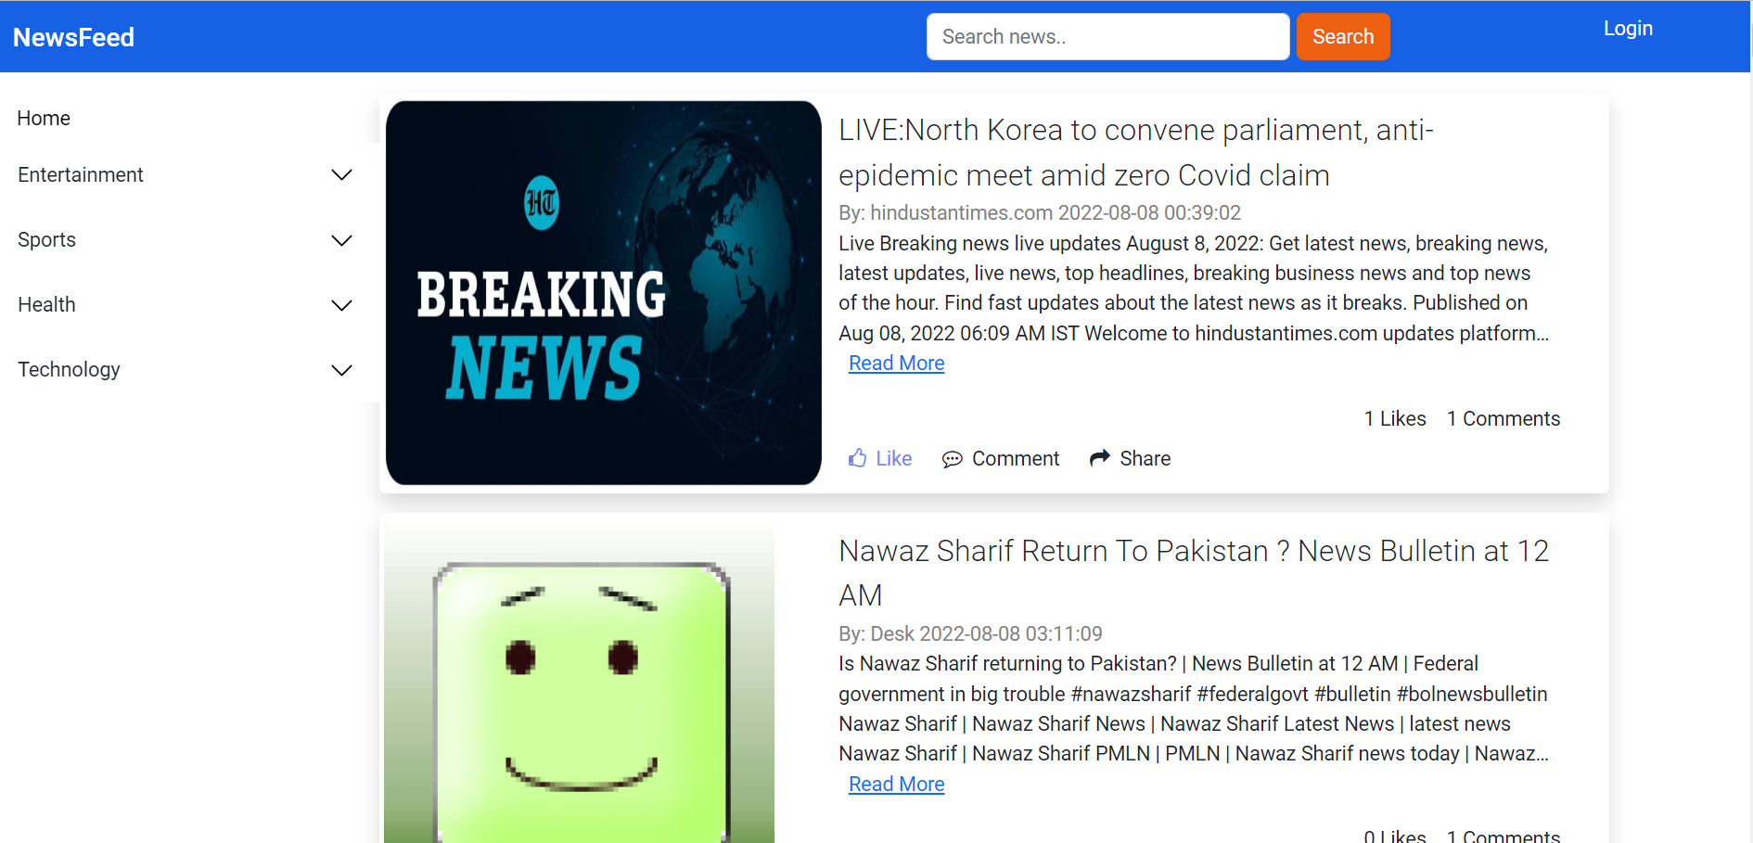
Home Page(Categories)

Slide 12
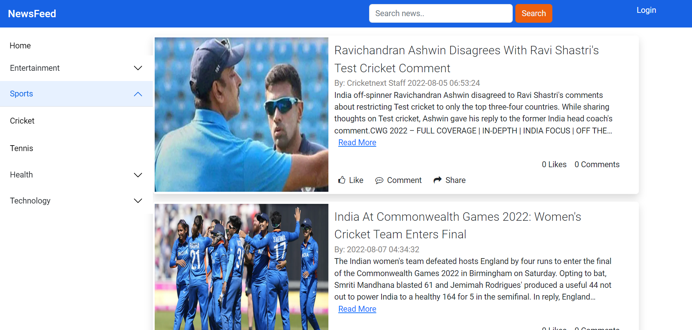
Subcategories pages-1

Slide 13
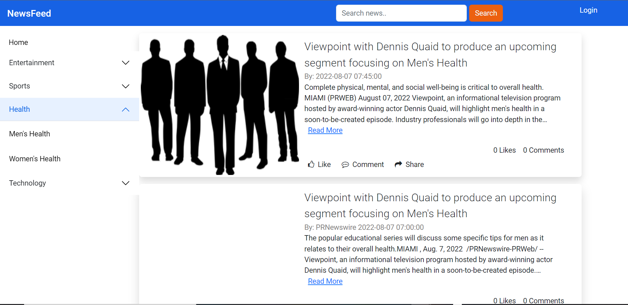
Subcategories pages-2

Slide 14
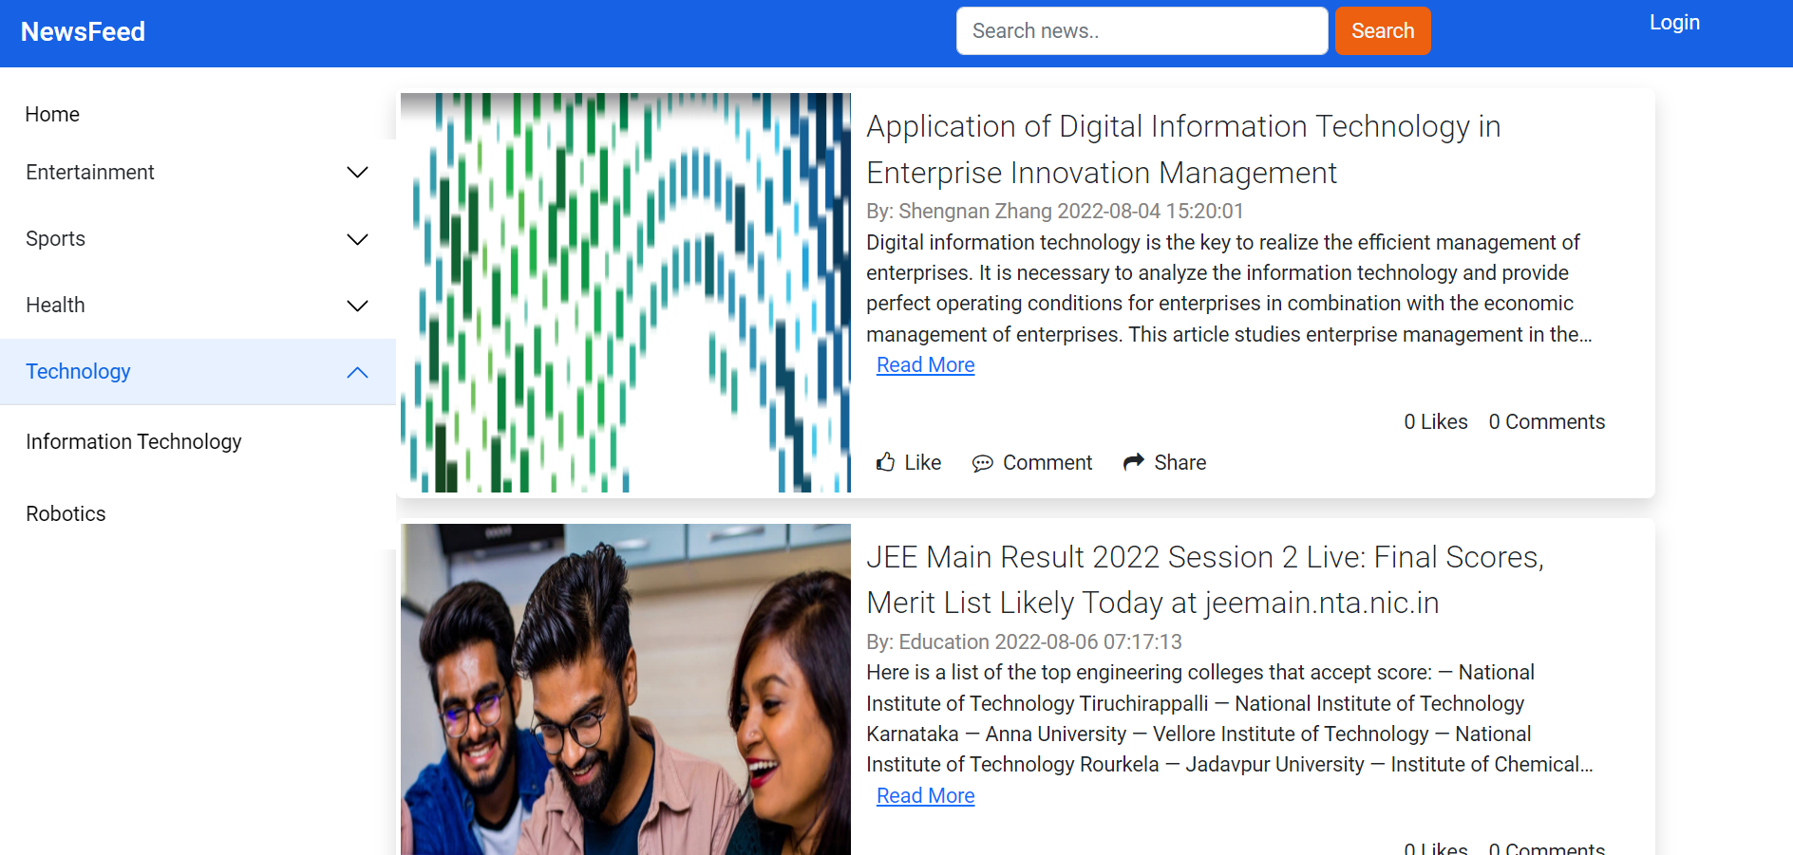
News page

Slide 15
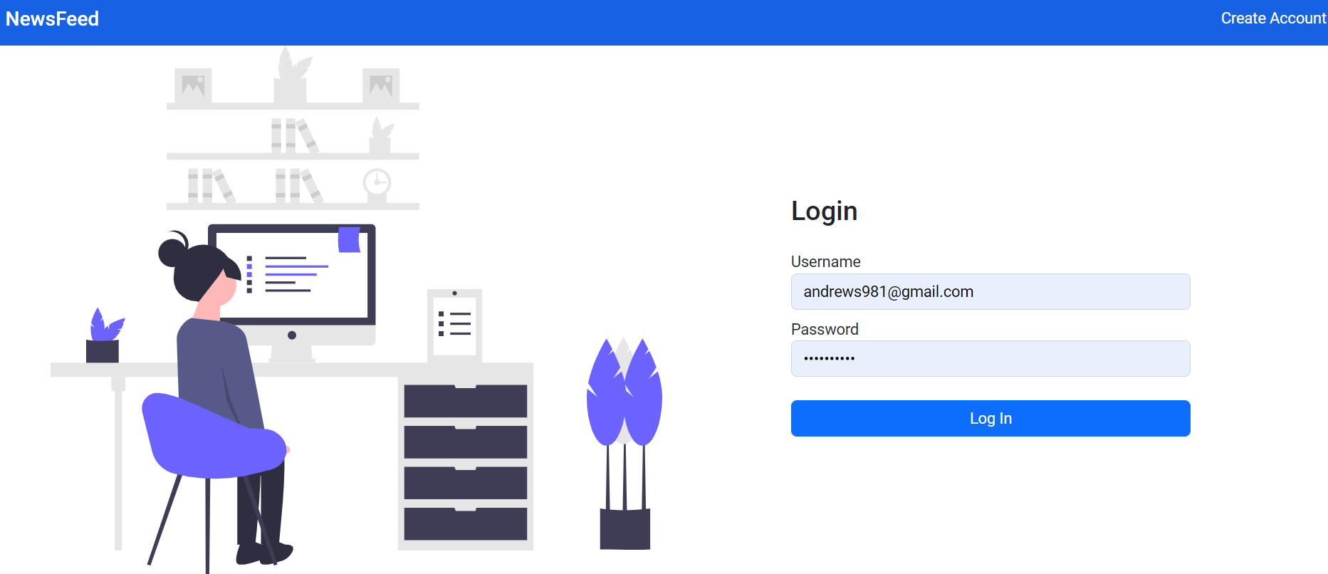
Login Analytics

Slide 16
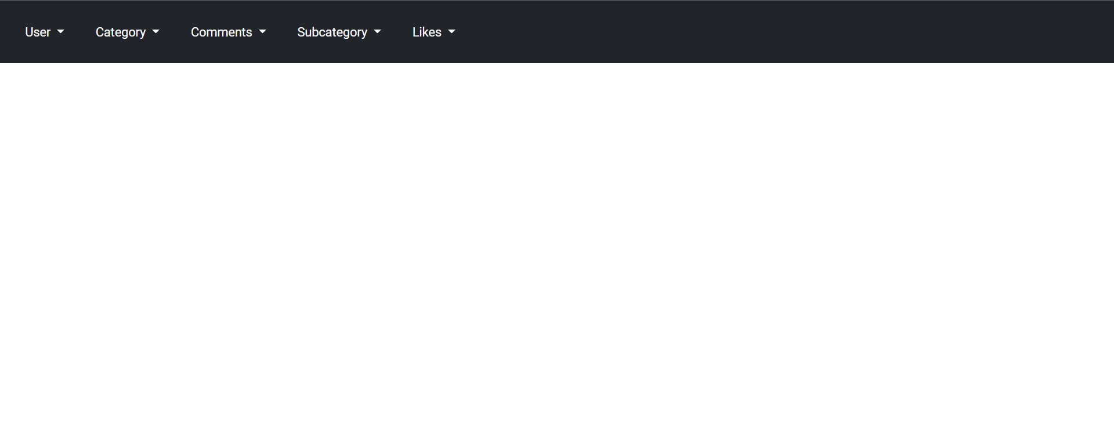
Admin Analytics

Slide 17
Like Article

Slide 18
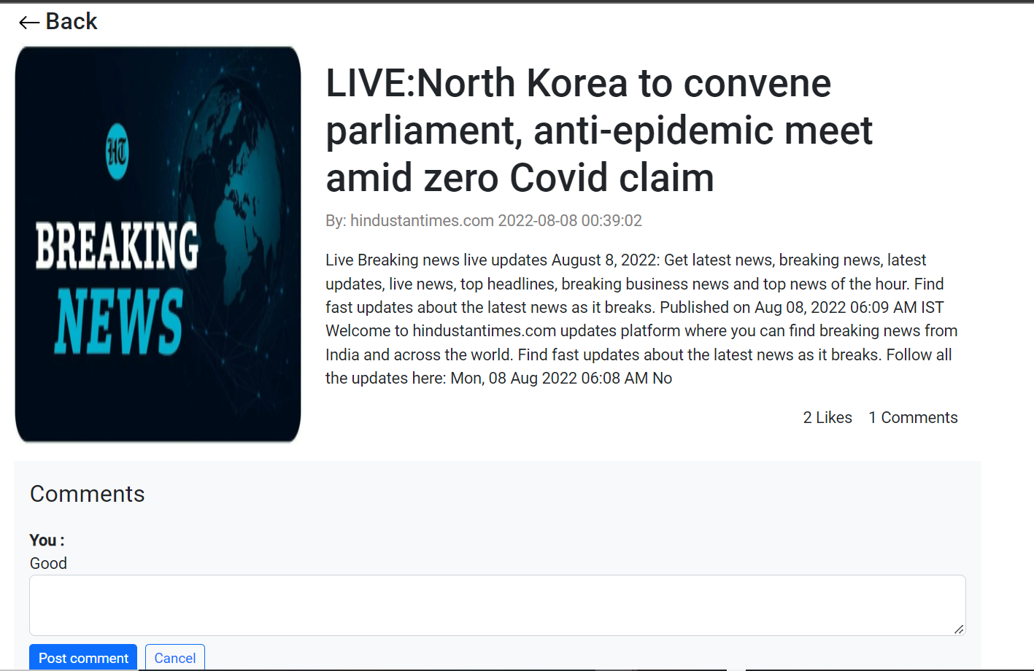
Comment Article

Slide 19


